Slide 1
Implementing the Mathematics Common Core
Module 2: Talking About Computational Procedure: Focus on Fact Fluency
Can talk be used to assist students in obtaining computational proficiency?
Sarah Roggensack & Shelace Shoemaker
Notes:
The following slides are for Options 1: Recommended for sites where fact fluency is a Tier 1 instructional concern
Background for Facilitator:
Materials needed:
Have participants bring: CCSS-M (NACS), pencil, highlighters
Make copies of: Basic Math Facts article, Operations & Algebraic Thinking Progressions pp. 17-18, Jigsaw Note Taker, Phases articles, Standards vs. Algorithms Hunt, Planning Note Taker

Slide 2
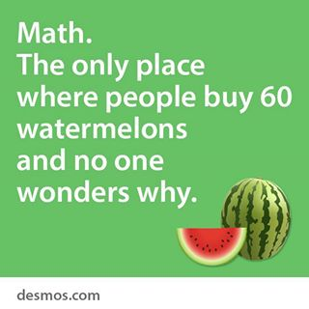

Slide 3
Whole class discussions can help students use computational procedures in accurate and efficient ways.
Discussion can help students build connections between procedures and their underlying concepts.
Classroom discussions can help students think of computational skills as tools that can be used to solve a wide variety of problems.
Learning based on memorization is often forgotten and not readily transferred.
Notes:
Background for Facilitator:
The above statements came from Classroom Discussions in Math p. 120 “About This Chapter”
Presentation:
Distribute “Stop and Jot” note taker document to teachers.
Say, “Stop and Jot what your thoughts are regarding these statements in the middle column.” After individuals have written their own thoughts, share out with a partner. This will be revisited at end of the presentation, as an exit ticket.

Slide 4
Essential Questions
What strategies can we use to enhance our instruction so students learn mathematics with understanding?
What does this look and sound like?
Notes:
Background for Facilitator:
Presentation:

Slide 5
Objectives
Explore what research says about productive procedural fluency development and instruction.
Develop an implementation plan for fact fluency instruction and assessment in your classroom.
Notes:
Background for Facilitator:
Presentation:

Slide 6
Four Steps Toward Productive Talk
Helping Individual Students Clarify and Share Their Own Thoughts
Helping Students Orient to the Thinking of Others
Helping Students Deepen Their Own Reasoning
Helping Students Engage with the Reasoning of Others
Notes:
Background for Facilitators: The purpose of this slide is to connect to prior learning from the Fall/Winter mathematics “pink” Wednesdays.
Presentation: Connection to the work that was engaged in the Fall 2013. The four steps provide a structure for analyzing and planning for components of productive classroom discussion.
Consider having participants think about the ‘talk moves’ they have been using to support the productive classroom discussion and moving student thinking and reasoning between these four steps.

Slide 7
Guiding Question
How can we use targeted and meaningful assessment for identifying students’ fact fluency instructional needs?
Notes:
Background for Facilitator:
Presentation: Here’s our guiding question for today’s work.

Slide 8
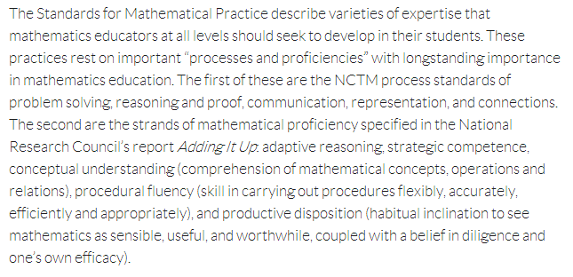
What is Fluency?
Standards for Mathematical Practice
Notes:
Option 1 (Hide slides 15-25)
Background for Facilitator:
This definition comes from p. 6 of the CCSS-M (NACS) in the Standards for Mathematical Practice
Presentation:

Slide 9
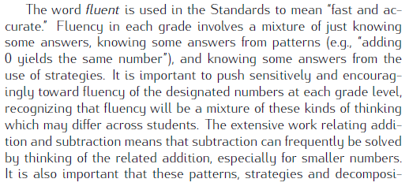
What is Fluency?
Operations & Algebraic Thinking Progression Document
Notes:
Background for Facilitator: Option 1
-This definition comes from p. 18 of the Operations & Algebraic Thinking Progression Document
-Van de Walle defines mastery of a basic facts as, “means that a child can give a quick response (in about 3 seconds) without resorting to nonefficient means, such as counting.” Teaching Student-Centered Mathematics Volume 1 Gr. Pre-K-3, Chapter 10 p. 153
-Van de Walle points out that, “When taught basic facts via rote memorization, many children with learning disabilities continue to use counting strategies because they do not independently develop thought processes or other strategies that move beyond counting. However, they can be very successful in learning their basic facts when the emphasis is on using strategies. In addition, drill can cause unnecessary anxiety and undermine children’s interested and confidence in mathematics.” Teaching Student-Centered Mathematics Volume 1 Gr. Pre-K-3, Chapter 10 pp. 154-155
-If available, read pp. 153-156 of Teaching Student-Centered Mathematics Volume 1 Gr. Pre-K-3
Presentation:
- Read from the beginning of the paragraph to the end of the highlighted portion.
-Say, “While the progressions do state that fluent is used to mean ‘fast and accurate’ fluency, ‘involves a mixture of just knowing some answers, knowing some answers from patterns,… and knowing some answers from the use of strategies.’”

Slide 10
How do we develop mathematical fact fluency?
All read and annotate the introduction of Basic Math Facts: A Sequence of Learning (stop at “Phases”)
Work in triads:
Each member read one of the Phases (bottom of pp. 1-2)
All read “Key Beliefs” (p.3)
Notes:
Background for Facilitator:
Read the article to become familiar with the content.
Presentation:
Annotate your portion, as your triad jigsaws note some ideas from the other two areas.
Ask: “How does what you read in the article differ from what we had before?”
Note: Have the triad share in order of the phases (Phase 1, then 2, then 3).
Link will send you to the wcsdcandi website.
The “Basic of Math Facts: A Sequence of Learning” is compiled from several sources including The National Council of Teachers of Mathematics, Van de Walle, Doug Clements, Marilyn Burns, and Kathy Fosnot.

Slide 11
Computational Procedures
Notes:
Background for Facilitator:
Hide this slide if you are doing this option after already presenting Option 2.
p.121 in Classroom Discussions in Math

Slide 12
Computational Strategy
A method where the numbers in a computation are manipulated in order to create an equivalent but easier computation.
Definable features:
The steps involved change depending on the specific numbers involved
Offer efficient and accurate ways to compute
Notes:
Background for Facilitator: Option 1 and 2
p.121 in Classroom Discussions in Math
Presentation:

Slide 13
Computational Algorithm
A generalized set of steps used to perform computations.
Definable features:
They are efficient
Produce accurate results
Can be used to perform many computations using the same process
Notes:
Background for Facilitator: Option 1 and 2
In the event that the questions get asked regarding what is “the standard algorithm,” Jason Zimba, a leading author of the CCSS-M (NACS), was quoted as saying, ”The standard algorithm is the algorithm that works for the student.” (NNMC Mini-Conference 3/8/14)
Presentation:
Strategies develop into algorithms for efficiency and generalization.
“When do we push for moving from strategies to algorithms?”: Our standards dictate when we move our instruction from strategy focus to algorithm.

Slide 14
Strategy vs. Algorithm Hunt
In each grade level indicate whether students are using a strategy (S) or an algorithm (A) as directed by the standards. Make additional notes regarding strategy vs. algorithm work for whole and rational numbers
.
 | Addition | Subtraction | Multiplication | Division
Kinder
1st
2nd
3rd
4th
5th
6th
Notes:
Background for Facilitator:
Hide this slide if you are doing this option after already presenting Option 2.
Notes: For time purposes you can choose whether or not to show teachers the search tool on their app to speed up this portion of the training. Extension: If you need it to take longer, (depending on how familiar teachers are with standards) have teachers include the boundaries: (ie: 1st grade addition strategies are “within 100, using concrete models or drawings and strategies based on place value; relate this strategy to written method and explain the reasoning used”.)
Presentation: Ask teachers to look at the standards for their grade. After, review the grades below and above to complete this chart. KINDER differentiation- After they’ve looked at 1st grade standards, ask kinder teachers to identify standards that support the work in first grade.

Slide 15
Strategy vs. Algorithm Hunt answers
 | Addition | Subtraction | Multiplication | Division
Kinder
1st | S | S
2nd | S | S | S
3rd | S & A | S & A | S | S
4th | A | A | S | S
5th | A S: decimals to hundredths | A S: decimals to hundredths | A: multi-digit whole numbers S: decimals to hundredths | S
6th | A multi-digit numbers & decimals | A multi-digit numbers & decimals | A multi-digit numbers & decimals | A multi-digit numbers & decimals
Notes:
Background for Facilitator:
Do a quick review of findings from this activity if you are doing this option after already presenting Option 2.
Familiarize yourself with the standards and whether your relating the strategy to written form, concrete models, drawing or if strategies are to based on place value.
Kinder only has “strategies” for comparing numbers by using matching and counting strategies.
Notes: For time purposes you can choose whether or not to show teachers the search tool on their app to speed up this portion of the training. Extension: If you need it to take longer, (depending on how familiar teachers are with standards) have teachers include the boundaries: (ie: 1st grade addition strategies are “within 100, using concrete models or drawings and strategies based on place value; relate this strategy to written method and explain the reasoning used”.)
KINDER differentiation: Consider asking Kinder teachers to share out the standards they found that support the work of first grade.
Presentation:
Teachers should also be familiar with standards and whether they should relate the strategy to written form, concrete models, drawing or if strategies are to based on place value.
Ask: “What are you noticing or What do you notice?”, “In what grade level do you see a strategy for rational numbers and an algorithm for whole numbers?”

Slide 16
 | K | 1 |  | 2 | 3 | 4 | 5 |  | 6
Whole Number Addition and Subtraction | C |  | P |  | S
Whole Number Multiplication |  |  |  | C | P | S
Whole Number Division |  |  |  |  | C | P | S
Fraction and Decimal Addition and Subtraction |  |  |  |  |  | C | P |  | S
Fraction and Decimal: Multiplication and Division |  |  |  |  |  | C |  | P | S
C | Development of Conceptual understanding of addition, subtraction, multiplication and division
P | Development of Procedures including fact fluency and algorithms
S | Expectations of Security of concepts and procedures
Notes:
Background for Facilitator: Option 1 and 2
-Hide this slide if you are doing this option after already presenting Option 2.
-If unfamiliar with Partial Product login into www.everydaymathonline.com
-Click on “Algorithms” tab on far right side of page
-Open “Algorithms Library of Animations”
-Open “Multiplication”
-Choose any of the “Partial Products” videos
Presentation:
Explain that the information in this visual refers to the computational expectations found in the CCSS-M (NACS) for grades K-6.
Say, “You still need to look closely at your standards as under a heading you may have some standards that are working on conceptual understanding, while others are procedural.”
This visual shows Whole Number Multiplication in grade 4 and Whole Number Division in grade 5 as a Standard Algorithm because of the phrase “relate to a written method” in the standards. However, this can be the writing out of the strategy, i.e. partial products.

Slide 17
Planning Note Taker
Phase 1: Descriptors |  |  | Phase 2: Descriptors |  |  | Phase 3: Descriptors
How are you going to assess which phase students are in?
How are you going to identify when a student is ready to move to the next phase? How frequently? | Where in your mathematical block are you going to build in instruction for students in their phase? | What will instruction look like in this phase (materials, activities, etc.)? | How are you going to identify when a student is ready to move to the next phase? How frequently? | Where in your mathematical block are you going to build in instruction for students in their phase? | What will instruction look like in this phase (materials, activities, etc.)? | How are you going to identify when a student is ready to move to the next phase? How frequently? | Where in your mathematical block are you going to build in instruction for students in their phase? | What will instruction look like in this phase (materials, activities, etc.)?
Notes:
Background For Facilitator:
Note 3-6: For 3rd grade teachers who are tempted to look at addition and subtraction: Tier 1 instruction should be focused on grade level standards, therefore they are looking at multiplication and division phases. If addition and subtraction is still a concern, then they should be addressed during intervention/remediation instructional blocks.
*These articles are lengthy and it’s unlikely that grade levels will finish all of the planning activities during this time. Consider formulating a plan with admin., following up in PLCs, etc. for completion and implementation.
Teachers may consider looking at eSuite “Assessment Differentiation Activities” to support these phases.
Presentation:
Decide as a grade level who will read and share out the individual “Phases” articles for operations in your grade level.
K-2: addition and subtraction
3-6: multiplication and division
Fill out the note taker with your grade level team.

Slide 18
Stop and Jot Exit Ticket
Stop and Jot: Instruction about Computational Procedures
Whole class discussions can help students use computational procedures in accurate and efficient ways.
Discussion can help students build connections between procedures and their underlying concepts.
Classroom discussions can help students think of computational skills as tools that can be used to solve a wide variety of problems.
Learning based on memorization is often forgotten and not readily transferred.
Notes:
Background for Facilitator:
Presentation:
“Stop and Jot any changes in thinking or evidence that strengthened your prior thinking in the final column.”
You may want to consider collecting this document to assess for future coaching needs.
Consider:
Invite participants to leave a comment on the bottom of document indicating whether they want additional support in computational procedures, classroom discussion, etc.

Slide 19
